Slide 1


Simple IoT with Azure Mobile Services
David Jones
Sportronics

Slide 2
David Jones
Embedded MVP
Melbourne, Victoria, Australia
@CEDriverWiz
davidjones@sportronics.com.au

Slide 3
Agenda
Microsoft Azure Mobile Service
AzMS HTML POST & GET
AzMS Telemetry Universal app
AzMS version 1 Tables
JSON
CEJSON, Ardjson
Post, Get, Update, Delete of telemetry data with AzMS
CEJSON Parsing of HTML Response from AzMS
AzMS Server side scripting

Slide 4
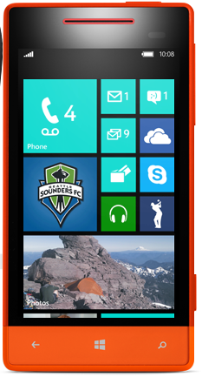
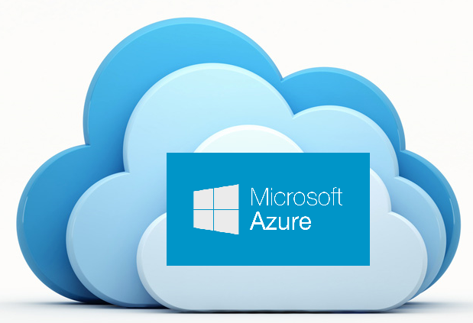
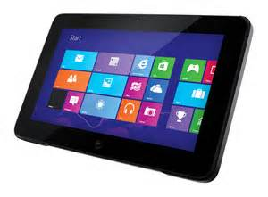
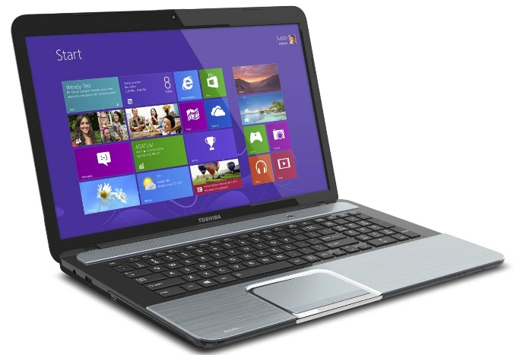
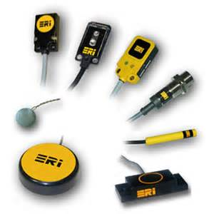
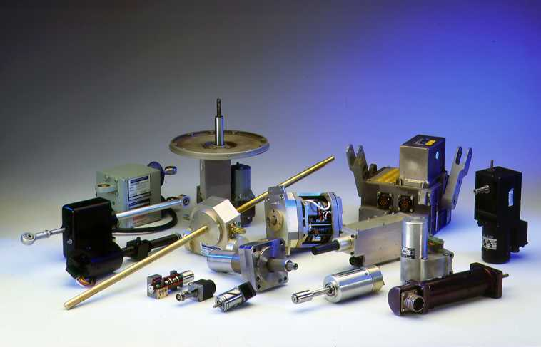
Simple Scenario
Azure Mobile Service
Users
The Cloud
Sensors
Actuators

Slide 5
Simple Take Homes
Internet of Simple Things is simple with Azure Mobile Services (AzMS).
AzMS uses standard HTML posts and queries
AzMS communications don’t need SSLs which is a Cloud enabler for many embedded devices.
When you create an AzMS service you get an option to create a sample Universal app that can communicate with an AzMS table (ToDo app). This app can run on Windows, Surface, Windows Phone, Android and IOS.
A variant of this to submit, read and modify telemetry data was covered.
The command line tool cURL is useful for testing the AzMS query syntax and API.
Some examples were given.
CEJSON and Ardjson, as available with full source, are libraries that simplify things further by abstracting the AzMS communication with simple devices ( Windows Embedded Compact/CE and Arduino).
A sensor collecting temperature and pressure data, submitting it to AzMS and then reading and modify that data with and to an Arduino device was demonstrated using Ardjson
Similarly, data was communicated with AzMS using CEJSON from an 86Duion device, as well as from a Windows console app..
Data received from AzMS is in JSON format which is simple to parse and is implemented as stream parser in CEJSON and Ardjson.
This was demonstrated on 86Duino and Arduino devices using the response from GET queries.
Some AzMS hints covered:
Create tables with JavaScript backend not .NET to keep things simpler
Use version 1 AzMS tables instead of the default version 1 to minimize the data received. (Use integer id field instead of a GUID).
This can’t be done in the Azure Portal so covered how to do this.
AzMS server side scripts intercept queries posted and can also modify the response. A custom set of Select queries is simplest to implement in AzMS GET queries.
Some example scripts for GET and POST were provided.

Slide 6
Microsoft Azure Mobile Service
Simple cloud backend to mobile apps
Backend can be JavaScript or .NET
24 x7 availability
Store data in SQL, Table Storage, and MongoDB
“Edge” can be anything that produces/consumes JSON over HTML
Windows Desktop, tablet, phone, handheld, embedded
IOS, Android
HTML
Can use cloud-based sync to build apps that work offline
Push notifications
Simple sign-on

Slide 7
AzMS Tables
Use Azure MS SQL Database for backend
Create an AzMS table and a mirror MS SQL table is created.
AzMS table is more “free-form” than MS SQL
Don’t need to define table fields
As records are posted, new fields are created to match as required.
For deployment this can be locked down.
Can simply add auto-generated fields in POST script
Can script field validation in POST as well
Id field: Primary key
Version 2 tables (default) 32 character GUID string
Auto-generate creation and modified dates
Version 1 tables (need to create manually) use auto-BigInt

Slide 8
AzMS REST Queries
Data is posted, updated, retrieved and deleted using HTML messages to the service.
Posted data is a single JSON object string
Retrieved data is returned as a JSON array of objects string
No nesting of object s (eg arrays within arrays). KIS

Slide 9
AzMS HTML Queries
POST: New record
GET: Get table contents
Can apply filters to enrich the selection
POST: Use PATCH
Requires the record id and modified name-values
Can only update one record, can’t update a selection
DELETE
Requires the record id
Can only delete one record, can’t delete a selection

Slide 10
AzMS Query Parameters
A query requires:
From the Azure Portal:
The AppKey
The AzMS URL
The table name (needs to exist)
The HTML Verb
Any data specific to the verb
In JSON format
The content type:
Set to json

Slide 11
An AzMS POST Query
POST /tables/telemetry2 HTTP/1.1
Host: sportronicsdj.azure-mobile.net
X-ZUMO-APPLICATION: NtcMLvQtuAqWtvXOwwZVQtpHevNUnN97
Content-Type: application/json
{"sensor":"temperature","value":27}
Content-Length: 31

Slide 12
A GET Response
[{id:56, "sensor":"Temperature","value":56},{id:63, "sensor":"Humidity", "value":90},{id:78,"sensor":"Pressure", "value":1002}]
The Response is a one line string

Slide 13
cURL.exe
curl is a command line tool and library
For transferring data with URL syntax
Can send HTML post and queries from a command line.
Windows version download available.
See links at end.
Useful for establishing correct syntax for messages with a service
cURL can send POST GET PUT (PATCH) DELETE and apply filters
See “cURL CRUD Examples” in links

Slide 14
cURL: POST a Name-Value pair to AzMS
curl -v -X POST -H Content-Type:application/json
-H X-ZUMO-APPLICATION:
NtcMLvQtuAqWtvXOwwZVQtpHevNUnN97
-d "{ \"sensor\":\"Temp1\",\“value\" : 42 }"
http://sportronicsdj.azure-mobile.net/tables/telemetry2
Note: All on one line

Slide 15
cURL: GET Query
curl -v -X GET -H Content-Type:application/json
-H X-ZUMO-APPLICATION:%AppKey%
"%AzureMobileServiceURL%/tables/%MSTable%
Note: All on one line
This is inside a batch file with Appkey etc declared earlier in the script.
Can apply filters to the query
Eg Append ?$filter=(startswith(sensor,'Temperature'))"

Slide 16
Demo: cURL

Slide 17
Azms Telemetry Universal App
When you create an AzMS service you get an option to create a sample ToDo Universal App that posts ToDo items to an AzMS table.
These are updated by checking tehethe items in the app.
Only incomplete (unchecked) items are displayed.
Available for a variety of platforms
The CEJSON/Ardjson Codeplex projects have a Telemetry app that has been morphed from the ToDo app:
Post telemetry data (sensor name and sensor value)
Retrieve telemetry data not marked as complete
Scan sensor data updating the table so that only the latest sensor values are tagged as incomplete.
Embedded devices then only get the relevant records.. Smaller.

Slide 18
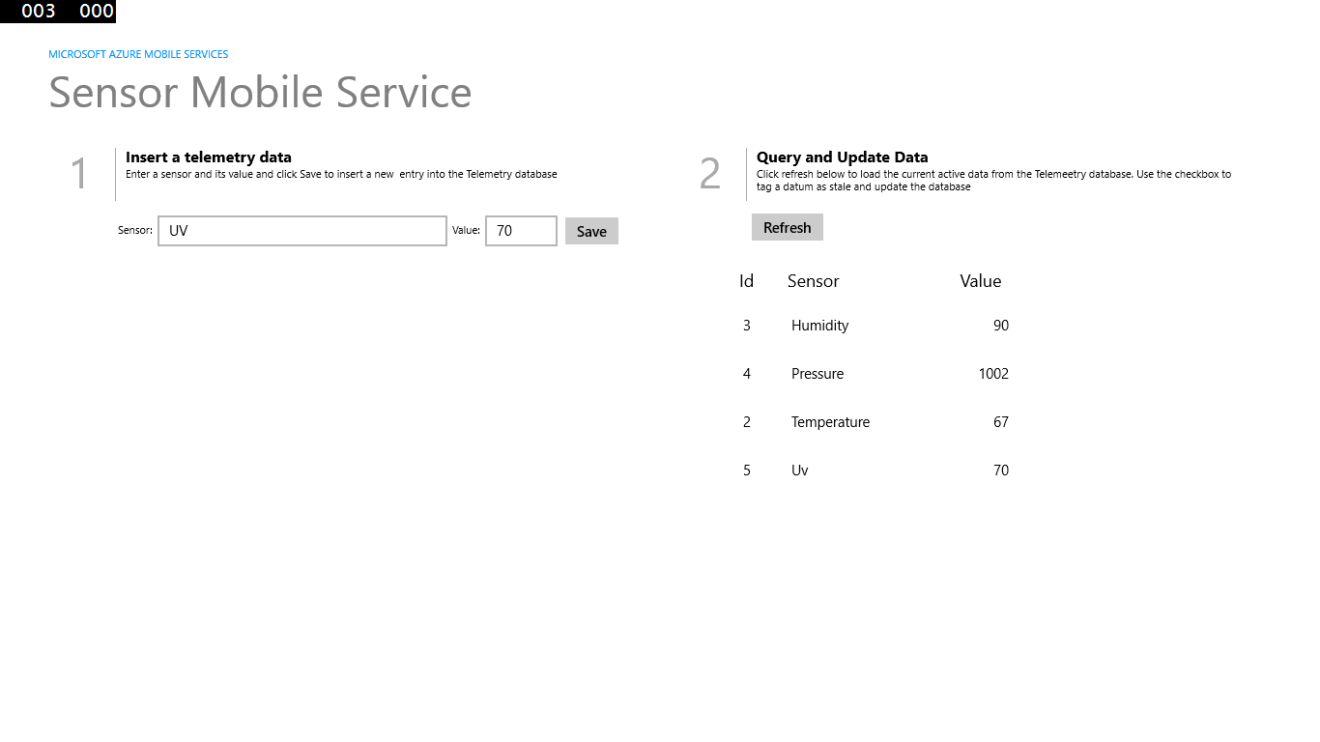

Slide 19
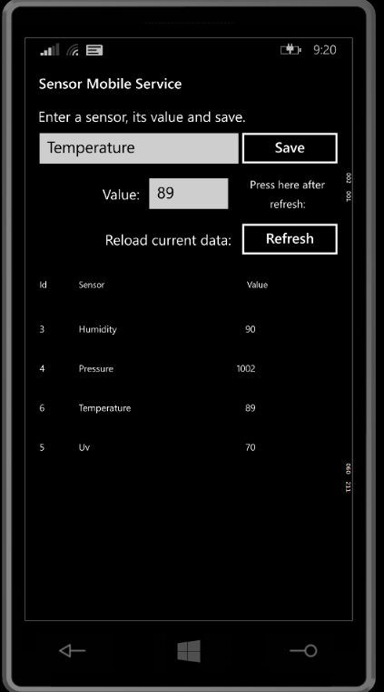
Telemetry App on Phone

Slide 20
Demo: Telemetry App + AzMS Tables
CEJSON: https://cejson.codeplex.com/
Ardjson: https://ardjson.codeplex.com/

Slide 21
The story so far ..
We can simply interact with an AzMS Table using .NET and Universal Apps
But what about embedded devices such as Windows Embedded Compact/CE and Arduino?

Slide 22
How to send these queries and get the response from embedded devices. How to interpret the response?
?

Slide 23
Embedded Issues
Don’t have a REST API
Resource restrictions
Can’t blindly download the whole of a table
Memory overload
Typically only want to
Read a sensor value from hardware
Upload a single name-value pair
Download only latest values for sensors
Actuate an actuator (eg Relay) if a sensor is above an alarm value

Slide 24
AzMS Version 1 Tables
By default AzMS Portal currently creates Version 2 tables auto-generating a 32 byte GUID string as the id (and primary key) field.
This is overkill for resource starved devices (such as Arduino).
Can use Version 1 tables instead but need to manually create form outside of the Azure Portal
Use an auto-generated (Big)Int
Much better for GET

Slide 25
Version1 Table: Example
Requires Microsoft Cross Platform Command Line Tools (See Links)
Prompt>azure account download
info: Executing command account download
info: Launching browser to http://go.microsoft.com/fwlink/?LinkId=254432
help: Save the downloaded file, then execute the command
help: account import <file>
info: account download command OK
Prompt>azure account import c:\azure\credentials.publishsetting
info: Executing command account import
info: account import command OK
Prompt>azure mobile table create --integerId sportronicsdj telemetry2
info: Executing command mobile table create
+ Creating table
info: mobile table create command OK
Prompt>
Login with Azure credentials
Save the file when prompted without spaces
Service name is name of service not URL

Slide 26
A Version 1 Table
telemetry2
Browse Script Columns Permissions
id sensor value
1 Temperature1 562
2 Temperature2 134
3 Humidty1 67
4 Humidty2 78
5 Temperature1 926

Slide 27
Demo: AzMS Version 1 Tables
About Version 1 AzMS Tables: http://tinyurl.com/kkq94xv
MS Cross-platform Command Line Tools Installer: http://tinyurl.com/pobnx8j

Slide 28
REST
HTML queries with AzMS are REST
Representational State Transfer.
It relies on a stateless, client-server, cacheable communications protocol
REST is a simple alternative to mechanisms like RPC (Remote Procedure Calls) and Web Services (SOAP, WSDL).
Uses JSON to format data.

Slide 29
JSON
JavaScript Object Notation
A lightweight data-interchange format.
Simple for humans to read and write.
Simple for machines to parse and generate
Many libraries available
Lighter than XML
Simple to pass over HTTP being textual
Has two entities:
Collection of name value pairs (object, record etc.)
Ordered list (array etc.)

Slide 30
JSON Entities
JSON Object (Record)
Colon separated name value pair
{Name:Value}
JSON Array
Comma separated list of values
[Value,Value,Value…]
JSON Array of Objects
[{},{],{},…]
Name: A string
Value: string,bool,int,float .. No DateTime

Slide 31
JSON Examples
Object
{"Name":"Jim", "Age":27, "Address":"Somewhere"}
{"date":"12/01/2015","sensor":"temperature1","alarm":"hi","resolvedq":"true"}
Array
[1,2,3,4]
["John", "Sue",Harry]
[{"Temp",23.5},{"Temp",23.6},{"Temp",33.2}]

Slide 32
Embedded REST
Need to be able to send restful requests from device over HTTP: GET, POST, PATCH and DELETE
Need to get the response:
Check for success or failure
When data returned (as JSON) need to parse it into records.
Arduino
Ethernet library supports HTTP REST messaging
Windows Embedded Compact/CE
Can implement HTTP requests using sockets

Slide 33
Ardjson
https://Ardjson.Codeplex.com
A project for submitting (POST) telemetry data to an AzMS table
Version 1 tables
Can also GET, PATCH and DELETE
Implements JSON stream parser for interpreting HTTP Response.
Can read data from Arduino sensors
Memory was a big issue with this device so had to optimise substantially.

Slide 34
Demo: Ardjson
https://Ardjson.Codeplex.com

Slide 35
CEJSON
https://CEJSON.Codeplex.com
A project for submitting (POST) telemetry data to an AzMS table
Version 1 tables
Can also GET, PATCH and DELETE
Implements JSON stream parser for interpreting HTTP Response.
Available as an app with command line options
Also as a DLL library (under development). ..Extensible
Windows Console Version as well Compact 2013
Simple to port to Compact 7 and CE6

Slide 36
CEJSON Command Line
CEJSONApp {GET|POST|PATCH|DELETE} {Filter} {id} {Field}/Sensor name} {Sensor/Field value}
CEJSONApp GET
CEJSONApp GET <Filter>
Filter can be any valid AzMS Filter. Some telemetry2 specific ones:
CEJSONApp GET embedded={1|2|3}
1 is the default
CEJSONApp GET sensor=<Sensor name>
CEJSONApp POST <Sensor name> <int Sensor value>
CEJSONApp {PATCH|PUT} <id> <Field name> <int Field value>
CEJSONApp DELETE <id>
Only first 3 characters of verbs are important.
ie Can be GET POS PAT PUT or DEL
Defaults to GET.

Slide 37
Parsing of JSON Response
JSON is human readable so creating a parser is not to difficult.
Initially with Ardjson the whole response was save then parsed.
Was simple to run out of RAM
So stream parser as a state machine was developed.
Parser implemented as a function that takes one character
The state of the parse is maintained between calls.
Its essentially one big switch statement based upon the current state

Slide 38
JSON Parser States
startOfArray,
startOfRecord,
startOfName,
gettingName,
nameValueSeparator,
startOfValue,
gettingValue,
gettingEndOfValueORRecord,
gotEndOfRecord,
gettingRecordSeparator,
done,
error,
gettingString,
gettingBoolean,
gettingInteger,
gettingFloat,
gettingNull

Slide 39
Demo: CEJSON Desktop and 86Duino (Compact 2013)
https://CEJSON.Codeplex.com
Notes:
Demo: Windows Desktop Version as well as Compact 2013 86Duino version

Slide 40
CEJSON Documentation as Blogged on Embedded101.com
CEJSON - 1: IoT on Windows Embedded Compact with Azure Mobile Services
CEJSON - 2: IoT on WEC 2013 with AzMS – CRUD Primitives
CEJSON - 3: IoT and Azure Mobile Service Scripts
CEJSON – 4: IoT Version 1 Azure Mobile Service Tables
CEJSON – 5: IoT The JSON Parser
CEJSON – 5.5: The Parser source code in detail
Index to above: http://cejson.codeplex.com/documentation

Slide 41
AzMS Server Side Scripting
AzMS supports filters as part of HTTP GET
See “cURL CRUD Examples” (See links)
Can be simpler to implement a set of “allowed” queries on the server side.
AzMS has a script for each of POST, GET, PATCH and DELETE which can be modified
Insert, Read, Update and Delete respectively
Can modify via Azure Portal
No cur and paste
Simpler to access from Visual Studio

Slide 42
AzMS Script Uses
POST
Add additional fields or auto-set field values
Create DateTime
Record as fresh (complete=false)
‘Normalise’ sensor names
Validate valuse
GET
Restrict records to only those incomplete
Vary the fields returned
Return all records for a specific sensor

Slide 43
Demo: telemetry2 Scripts
Show Read and Post scripts
Notes:
Demo: Windows Desktop Version as well as Compact 2013 86Duino version

Slide 44
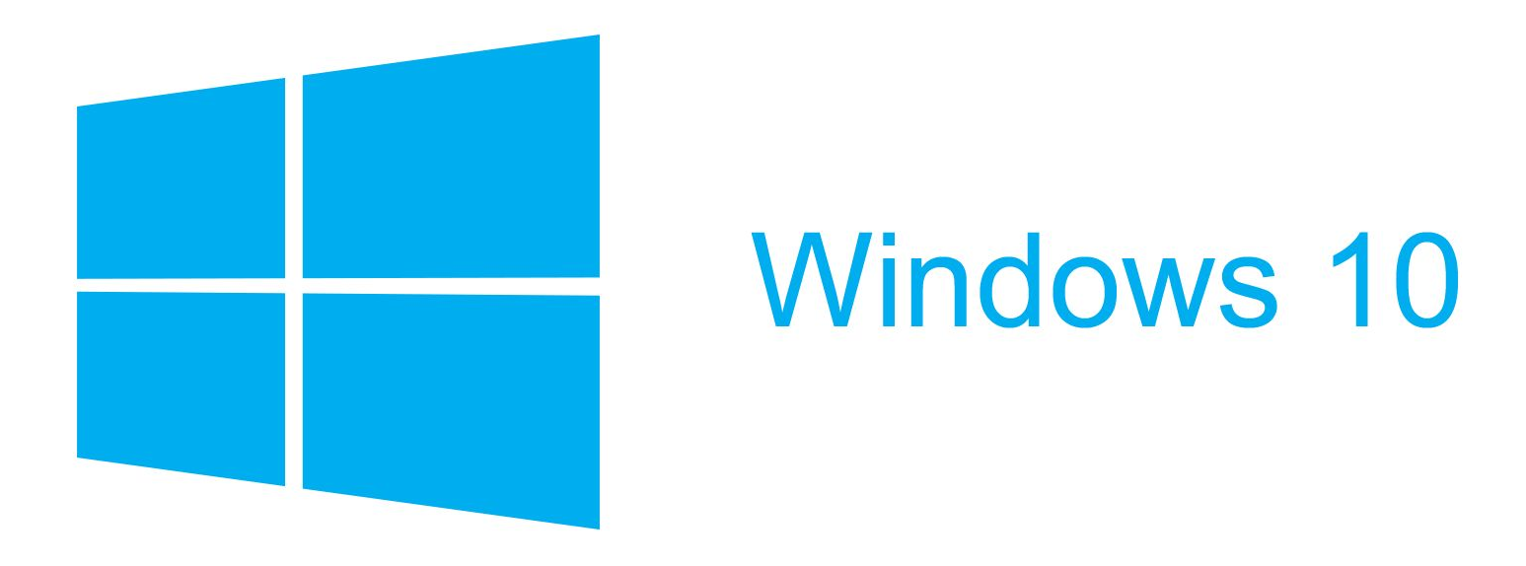
The Future: Windows 10
Desktop, Tablet, Industry
Handheld & Phone
Universal Apps
Embedded / IOT

Slide 45
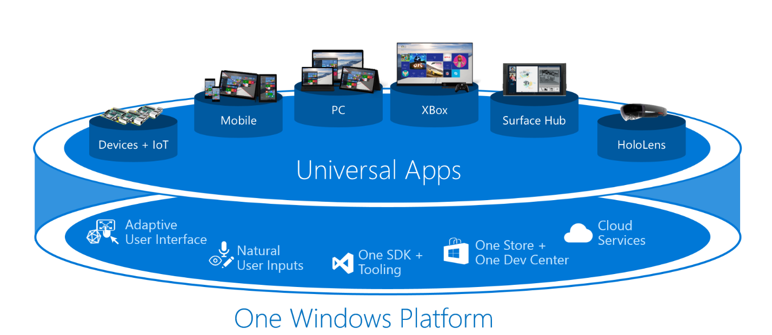

Slide 46
Links
Azure: http://azure.microsoft.com/en-us/
CEJSON: https://cejson.codeplex.com/
Ardjson: https://ardjson.codeplex.com/
cURL: http://curl.haxx.se/
“cURL CRUD Examples”: http://tinyurl.com/nzxb3sr
About Version 1 AzMS Tables: http://tinyurl.com/kkq94xv
MS Cross-platform Command Line Tools Installer: http://tinyurl.com/pobnx8j
http://cejson.codeplex.com/documentation

Slide 47
David Jones
Embedded MVP
Melbourne, Victoria, Australia
@CEDriverWiz
davidjones@sportronics.com.au

Slide 48


